Slide 1
Secure Data Hiding In Images Using Steganography
CAPSTONE PROJECT
Presented By: Kunal Dhibar
Student Name: Kunal Dhibar
College Name: Haldia Institute of Technology
Department : CSE(Cyber Security)

Slide 2
OUTLINE
Problem Statement
Technology used
Wow factor
End users
Result
Conclusion
Git-hub Link
Future scope

Slide 3
Problem Statement
Conventional encryption techniques can be easily identified, potentially drawing unwanted attention.
A method is required to discreetly embed confidential messages within images for enhanced security.
It is essential to safeguard sensitive data while preserving the original appearance of the cover image.
Simplifying encryption and decryption processes to make them user-friendly for individuals without technical expertise.

Slide 4
Technology used
Programming Language: Python
Image Processing Library: OpenCV
File Handling & Security: Basic encryption logic for password protection
Platform: Windows 11(OS)
Code Editor: Idle shell 3.10.5

Slide 5
Wow factors
Steganography is utilized to seamlessly conceal messages within images without altering their visible appearance.
The encryption and decryption logic is implemented using the Python programming language.
Supports a variety of standard image formats, ensuring broad compatibility(Jpg format is uploaded in github).

Slide 6
End users
Cybersecurity Enthusiasts – Discovering advanced techniques for secure communication.
Government & Defense – Ensuring covert message transmission without detection.
Journalists & Activists – Hiding sensitive data in images to bypass surveillance.
Software Developers – Exploring steganography and its real-world applications.

Slide 7
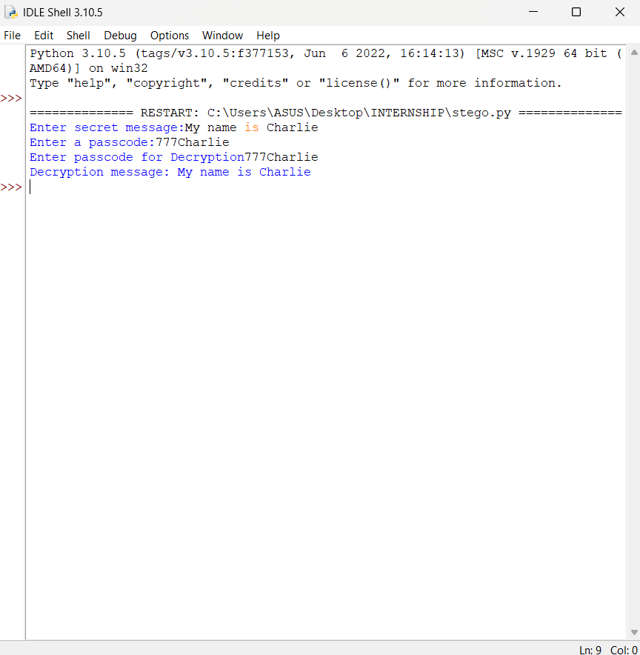
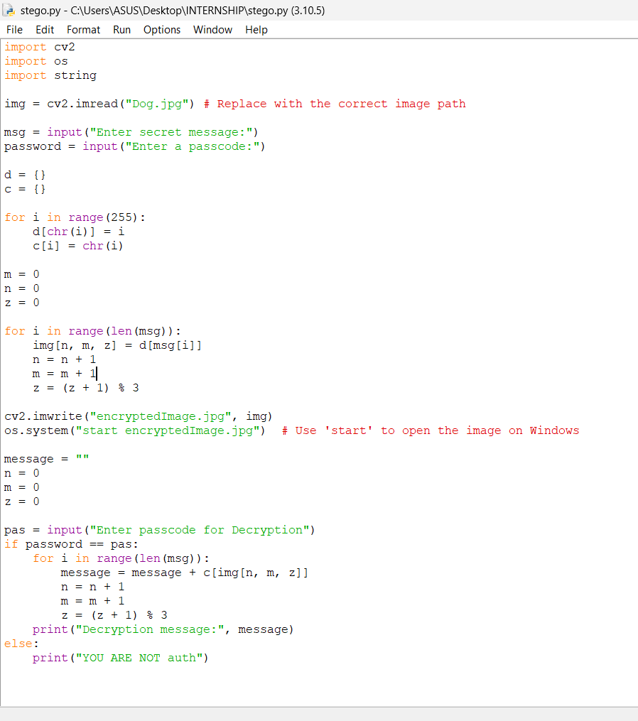
Results
Output Compiled Filed:
Source Code:

Slide 8


RESULTS
Orignial image:
Encrypted Image:

Slide 9
Conclusion
Steganography enables safe and discreet transmission of sensitive data.
This project demonstrates an easy yet powerful method for hiding messages in images.
Future enhancements can strengthen security, scalability, and overall reliability.
Continuous improvements can make the system more robust for real-world applications.

Slide 10
GitHub Link
https://github.com/KunalDhibar7/STEGO_AICTE-PROJECT

Slide 11
Future scope
Stronger Encryption – Implement AES encryption before embedding text in images.
Beyond Images – Extend steganography to audio and video formats.
AI-Resistant Methods – Develop techniques to bypass advanced forensic detection.
Cross-Platform Access – Enable usage through mobile apps and web platforms.
Multi-Layer Security – Combine steganography with blockchain for enhanced protection.

Slide 12
THANK YOU

